Slide 1
Welcome and Overview

Slide 2
LOCAL SUB INTRO (Optional)

Slide 3
Course Goals
Provide a jumpstart on development for Azure and Office 365
Understand the options for your platform of choice
Windows, Linux, OSX
CODE, CODE, CODE

Slide 4
Quick Introduction
Who am I?
Who are you?
Company and role
Experience with cloud
What is your platform of choice?
What are you looking to learn?
What is Azure?

Slide 5
Microsoft Cloud
Secure Productive Enterprise &
Operations Management + Security
Cortana Intelligence Suite
Office 365
Dynamics
Azure
PRODUCTIVITY
BUSINESS APPS
SECURITY & MANAGEMENT
DATA & INTELLIGENCE
APPLICATION INNOVATION

Slide 6












7+ billion
worldwide queries each month
50+ billion
minutes of connections handled each month
250+ million
active users
85%
Fortune 500 users
2.4+ million
emails per day
30+ trillion
objects stored
3.5+ million
subscribers
48+ million
users in 41 markets
50+ million
active users
400+ million
active users
18+ billion
Active Directory authentications per week
200+ Cloud Services
1+ billion customers · 20+ million businesses · 90+ markets worldwide

Slide 7
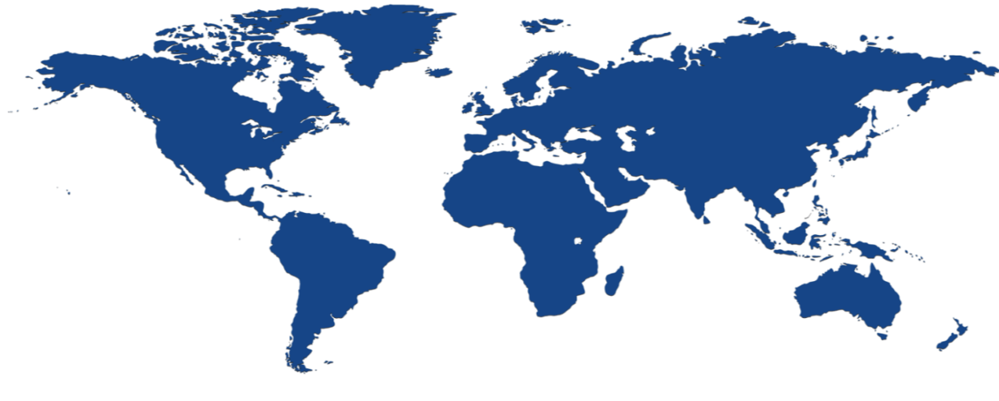


Achieve global scale, in local regions
38
regions
Over 1M+ production servers Dark fiber network 24 x 7 x 365 support
Notes:
The security controls we apply to development, infrastructure, operations, and compliance apply to our global customer base. Customers can explicitly choose which regions to deploy and store their data according to local privacy, security, or compliance requirements.
On this slide you can see the 38 regions where we operate (26 are active), including:
Public cloud regional datacenters with geographic diversity. Customers can deploy two identical workloads in different regions with an Active/Active failover model. This can ensure business continuity in the event of a local disaster.
Local and sovereign cloud. In-country Microsoft datacenters address data residency requirements, and we’re using a combination of technology as well as a legal framework to legally isolate certain regions of the world according to local sovereignty, governance, and rule of law, all the while providing the same exact up to date set of services in those regions.
There are four sovereign clouds today and four more planned, including Germany for example, as well as:
US Gov (2)
China North Beijing
China South Shanghai
Planned:
Germany Central
Germany Northeast
US DoD East
US DoD West

Slide 8

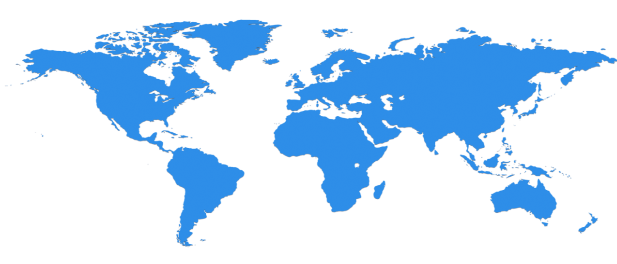
Hyper scale Infrastructure is the enabler
28 Regions Worldwide, 22 ONLINE…huge capacity around the world…growing every year
North Central US
Illinois
United Kingdom
Regions
West Europe
Netherlands
Central US
Iowa
Canada Central
Toronto
Canada East
Quebec City
Germany North East **
Magdeburg
China North *
Beijing
US Gov
Iowa
North Europe
Ireland
Germany Central **
Frankfurt
China South *
Shanghai
Japan East
Tokyo, Saitama
West US
California
East US
Virginia
India Central
Pune
Japan West
Osaka
South Central US
Texas
East US 2
Virginia
US Gov
Virginia
India South
Chennai
India West
Mumbai
East Asia
Hong Kong
SE Asia
Singapore
Australia East
New South Wales
38
Regions
Brazil South
Sao Paulo State
Australia South East
Victoria
Over 1M+ production servers Dark fiber network 24 x 7 x 365 support
Notes:
Once they stood in the data center, that’s when it hit them. Once Vincent Capezuto, CTO for Aireon, stood in the data center and saw the massive size of an Azure data center, he understood the massive scale opportunity, one that he wanted to leverage. His next question was even more telling: “How many of these data centers do you have?”
This is SUCH a big investment – it’s a game for only very few. It’s not new for us – we have been doing this for our own services and our consumer/web properties for 20+ years. We continue to innovate, with high efficiency solutions, and at this scale it enables us to reduce our operating cost and reduce the cost of our services.
We will be in the major places, but not everywhere – we have Azure Stack/Hosters for that.

Slide 9
Momentum
120,000
New Azure customer subscriptions/month
150 billion
Azure SQL query requests processed/day
>85%
of Fortune 500 use Microsoft Cloud
715 million
Azure Active Directory users
120 billion
Hits to websites run on Azure Web App Service
Notes:
We’ve had incredible momentum in the last year with over 85% of Fortune 500 companies using the Microsoft Cloud.

Slide 10
Azure & Office 365 2-Day DevCamp

Slide 11
Course Agenda
Module 1
Module 2
Module 3
Module 4
Module 5
Module 7
Module 8
Setting up your developer environment
Building modern cloud apps
Identity with Azure AD and Office 365 APIs
DevOps with Azure and Visual Studio Team Services
Module 6
Introduction to Docker and Azure container service
Lap around other Azure dev focused features
ARM and Infrastructure as Code
Monitoring applications with App Insights

Slide 12
Hands on labs
HOL 1
HOL 2
HOL 3
HOL 4
HOL 5
Setting up your developer environment
Building modern cloud apps
Identity with Azure AD and Office 365 APIs
DevOps with Azure and Visual Studio Team Services
Infrastructure as code with Azure Resource Manager (ARM)
HOL 6
Monitoring applications with App Insights

Slide 13
Day 1 – Detailed Agenda
9:00 AM – 9:30
Overview
9:30 – 10:15
Tools and developer environment overview
10:15 – 10:45
HOL 1 - Tools and Developer Environment Setup
10:45 – 11:00
Break
11:00 -11:30
HOL1 - Tools and Developer Environment Setup (Cont'd)
11:30 - 12:15 PM
Modern Cloud Apps + Demo
12:15 -1:00
Lunch
1:00 - 2:00
HOL 2 - Modern Cloud Apps
2:00 - 2:15
2:15 - 3:15
Identity and Office365 APIs Overview + Demos
3:15 - 4:45
HOL 3 - Identity and Office365 APIs
4:45 - 5:00
Break
Q&A

Slide 14
Day 2 – Detailed Agenda
9:00 AM-9:15
10:00 - 10:15
10:15 - 11:15
12:00 - 1:00
4:00 - 4:45
5:15 - 5:30PM
Recap
9:15 - 10:00
Q&A
Lap around other Azure dev focused features
Containers (Docker, ACS) + Demo
4:45 - 5:15
HOL 6 - Monitoring applications with App Insights
Monitoring Lecture + Demo
3:00 - 4:00
Break
2:15 - 3:00
HOL 5 - Infrastructure as code (ARM)
2:00 - 2:15
Lunch
1:00 - 2:00
Infrastructure as code (ARM) + Demo
HOL 4 - Continuous integration with VSTS
11:15 - 12:00 PM
Break
Continuous integration + Demo

Slide 15
HOL Agenda
HOL 1 - Tools and Developer Environment Setup
HOL 2 - Modern Cloud Apps
HOL 3 - Identity and Office365 APIs
HOL 4 - DevOps Continuous integration
HOL 5 - Infrastructure as code
HOL 6 - Monitoring

Slide 16
Intro to Scenario
City Power & Light is looking to use cloud capabilities
Would to allow field workers the ability capture incidents
Would like to provide photo upload capability
Would like to consume PaaS services on Azure

Slide 17
Demo
City Power and Light
Notes:
Demo steps
Show site
Login with Azure AD
Create new incident
Show dashboard
Show profile

Slide 18
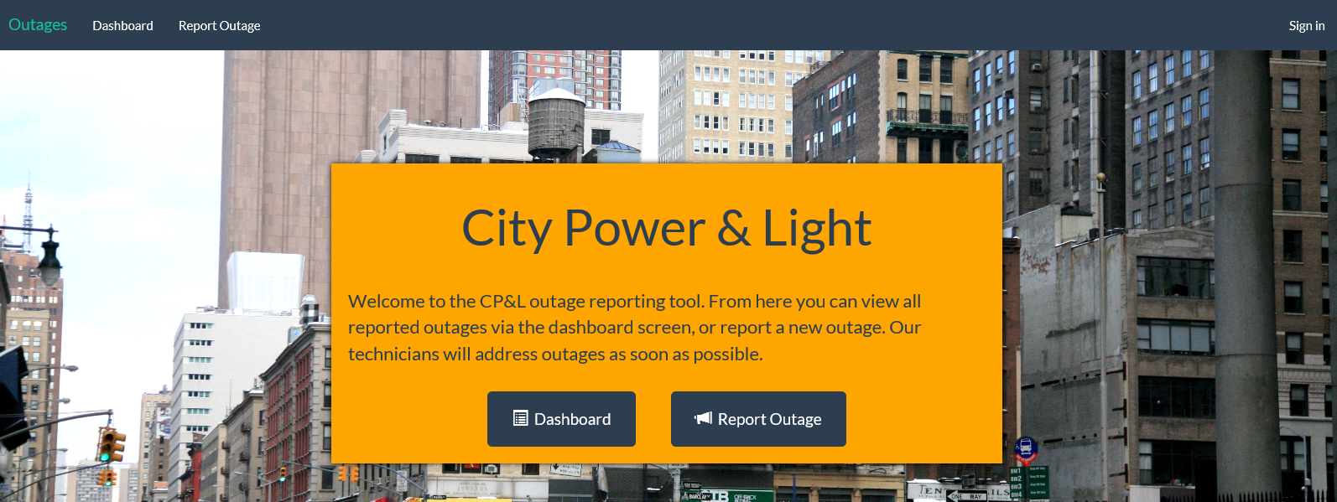
City Power & Light Outage Incident Tracker

Slide 19
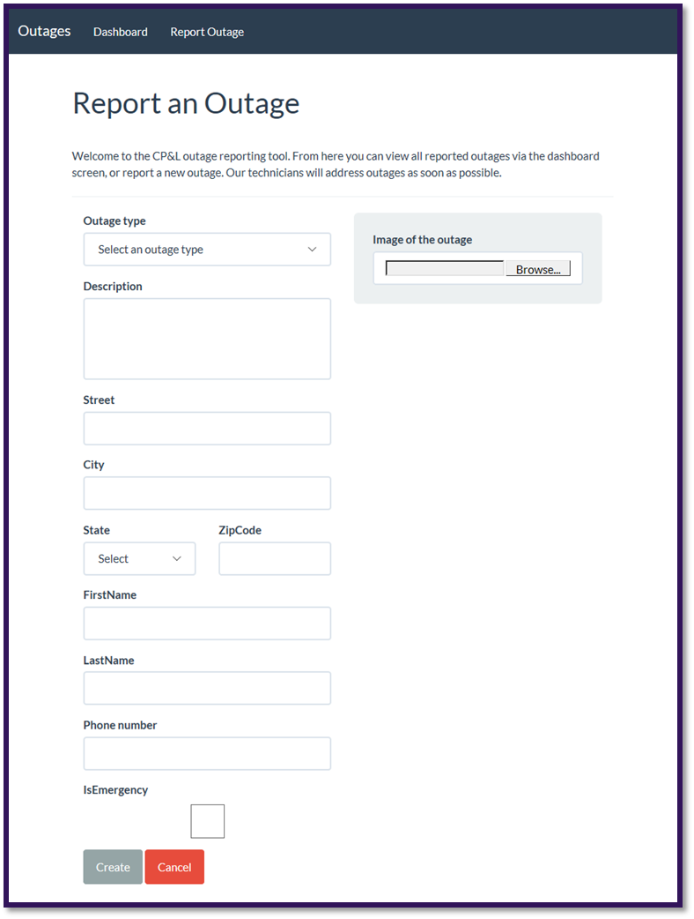
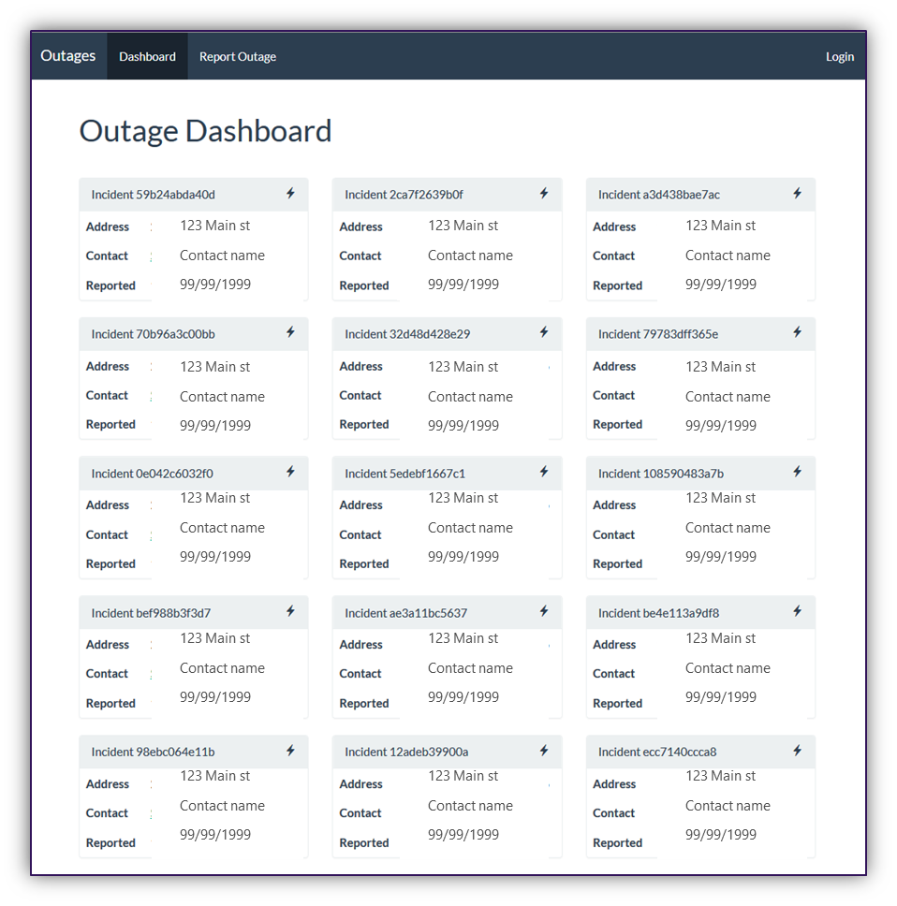
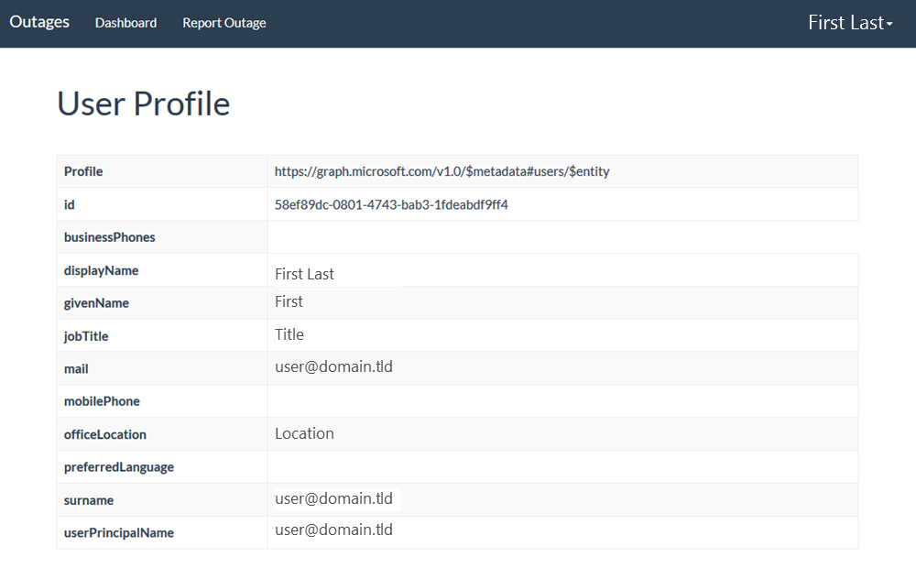
Screenshots

Slide 20




City Power & Light App Architecture
START
8
3
4
AZURE DOC DB
AZURE API APP
AZURE CACHE
1
Dashboard
WEB SITE
New Incident
Incident Tracker
Email
Images
6
AZURE QUEUE
2
7
5
9
AZURE BLOB STORAGE
AZURE FUNCTION
AZURE AD
O365 APIs

Slide 21
Components Covered in this Course
Azure
Azure Resource Manager
Virtual Machines (Windows)
Azure AD
Web Applications
API Apps
Redis Cache
Document DB
Office 365
Graph API (users, OneDrive for Business, Skype for Business)
Visual Studio Team Services
Source Control integration (GIT)
Continuous Integration & Delivery
Containers
Docker
Azure Container Service

Slide 22
Hands On Labs

Slide 23
HOL 1: Setting up your developer environment
Create O365 Developer Tenant
Connect Azure subscription (Pass or Trial)
Take prepared image or run locally, walk through the tools that are available for your platform
.NET, Node.JS, Java | Windows. Mac OSX
Run ARM Template to scaffold out resources

Slide 24
HOL 2: Building modern cloud apps
Starting with provisioned resource group
Select front end app (.NET/Node.js/Java)
Connect to deployed API
Add blob storage
Add queueing
Add Redis cache
Stretch: Image resizing with Azure Functions

Slide 25
HOL 3: Identity with Azure AD and Office 365 APIs
Create AAD Application
Add authentication to app
Add profile page
Add graph API call to get user data for profile page
Populate first & last name of the new incident form with first name & last name from Graph/token
Send Email via Graph on new incident creation
Stretch: Add calendar event on new incident creation

Slide 26
HOL 4: DevOps with Azure and VSTS
Create Visual Studio Team Services (VSTS) Online account
Create Git repository
Clone Git repo locally
Push code into VSTS
Create CI pipeline for build
Ends with published artifacts

Slide 27
HOL 5: Infrastructure as code with (ARM)
Create ARM template for web app in VS
Deploy using VSTS
Create 1 Production environment
Configure Continuous deployment

Slide 28
HOL 6: Monitoring applications with App Insights
Add App Insights resource to Azure
Add App Insights to application server side
Monitor the API call
Add client side library
Dashboard custom event to capture dashboard views
Create availability test that test the dashboard
Stretch - Create custom metric around the API call

